Slide 1

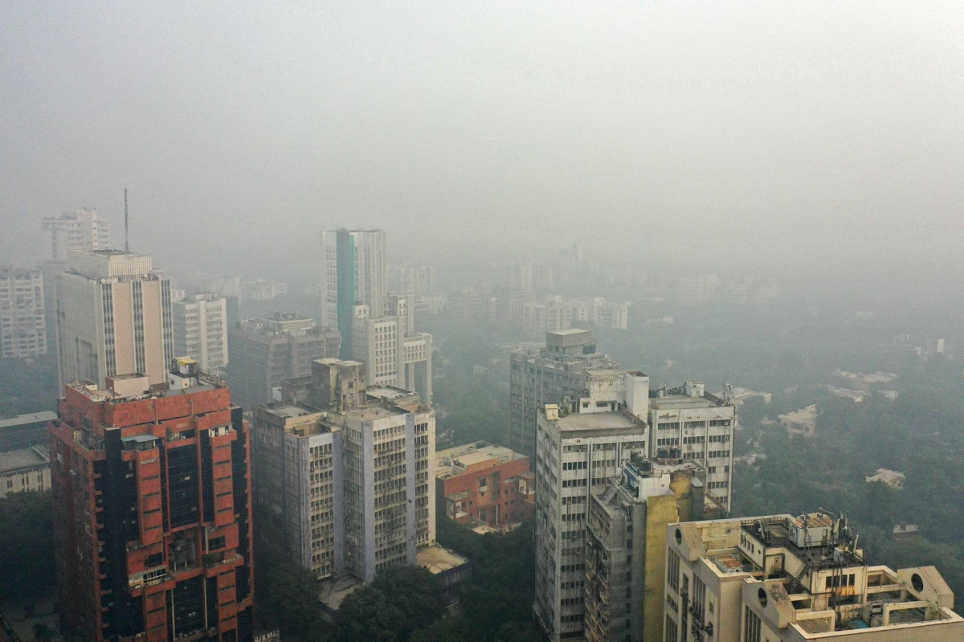
Air Quality Insights :
An Interactive AQI Monitoring Dashboard.
Fresh Air
27 December, 2025
Polluted Air

Slide 2


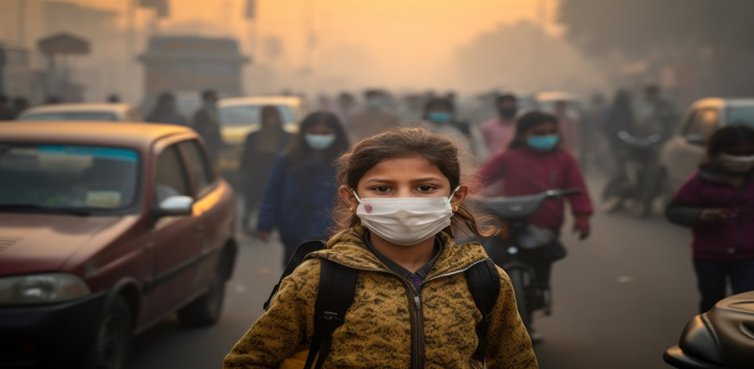
Why Does Air Quality Matter?
Introduction
🫁 Direct impact on human health (Respiratory issues, cardiovascular problems, asthma, etc.)
🌧️ Environmental consequences (Contributes to acid rain, harms wildlife and ecosystems)
💸 Economic impacts (Increased healthcare costs, reduced work productivity, pollution-related expenses)
🌍 Growing public awareness (Citizens demand cleaner air and real-time pollution data)

Slide 3
AQI Value | Air Quality Level | Health Advisory
1 | Good | Air quality is considered satisfactory.
2 | Satisfactory | Acceptable; some pollutants may affect sensitive individuals.
3 | Moderate | Everyone may begin to experience health effects.
4 | Poor | Health alert: serious risk of respiratory symptoms.
5 | Very Poor | Emergency conditions. The entire population is likely affected.
Understanding the Air Quality Index
Introducing
Air Quality Index (AQI)
The Air Quality Index (AQI) is a standardized scale used globally by health and environmental agencies to inform the public about current or forecasted air pollution levels. It helps people understand how safe or hazardous the air is to breathe
Key Pollutants Included in AQI:
PM2.5 (Fine Particulate Matter)
PM10 (Coarse Particulate Matter)
Ozone (O₃)
Nitrogen Dioxide (NO₂)
Sulfur Dioxide (SO₂)
Carbon Monoxide (CO)

Slide 4

Empowering Action Through Information
AQI dashboards turn data into action
Why We Need an AQI Monitoring Dashboard ?
Historical data analysis Spot trends and recurring patterns to understand pollution cycles and events
Personalized alerts and recommendations Warn users when AQI reaches hazardous levels based on their location or health.
Informed decision-making Helps citizens, health officials, and government bodies take timely action.
Centralized view of real-time AQI data Aggregate pollution data from multiple cities or regions in one place.
Easy-to-understand visualizations Bar charts, line graphs, and gauges help users interpret air quality instantly.

Slide 5
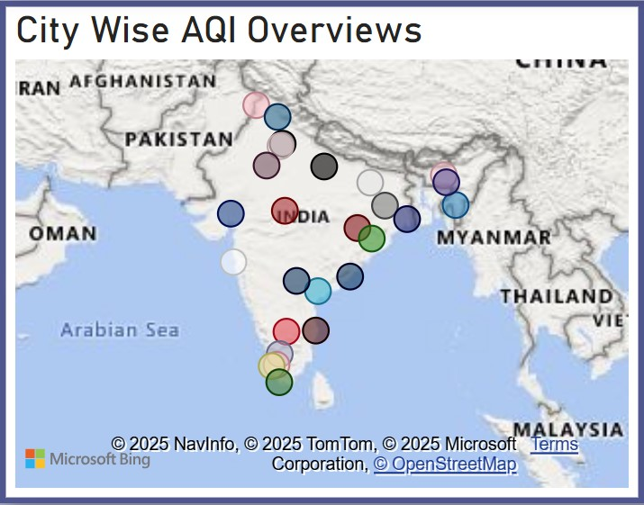
Objectives :
Display current AQI levels in a clear, user-friendly format.
Allow users to track AQI by location of interest.
Provide historical data for identifying air quality trends.
Highlight key pollutants contributing to poor air quality.
Deliver health-based recommendations based on AQI levels.
Health Consequences of Air Pollution
Key Features :
Interactive map with AQI data for different regions.
Live AQI readings updated in real-time.
Line charts showing AQI trends over days, weeks, or months.
Pollutant-specific breakdowns (PM2.5, CO, NO₂, etc.).
Color-coded indicators aligned with standard AQI levels.
What our Dashboard
will achieve

Slide 6

Technology Stack and Requirements
Data Source
Source: Kaggle Dataset (provided in Excel format - .xlsx or .csv).
Technology Stack
Data Handling & Preparation : Microsoft Excel (for initial exploration and potential minor cleaning).
Dashboarding & Visualization: Microsoft Power BI Desktop (for connecting to the Excel dataset, data modeling, creating visualizations, and building the interactive dashboard).
Our Toolkit :
Data and Visualization
Requirements
Access to the Kaggle Dataset: Downloading the Air Quality Index dataset from Kaggle.
Microsoft Excel: Software installed for initial data review.
Microsoft Power BI Desktop: Software installed on your local machine.
Understanding of Power BI: Familiarity with connecting to data sources, creating data models, and building visualizations within Power BI Desktop.

Slide 7
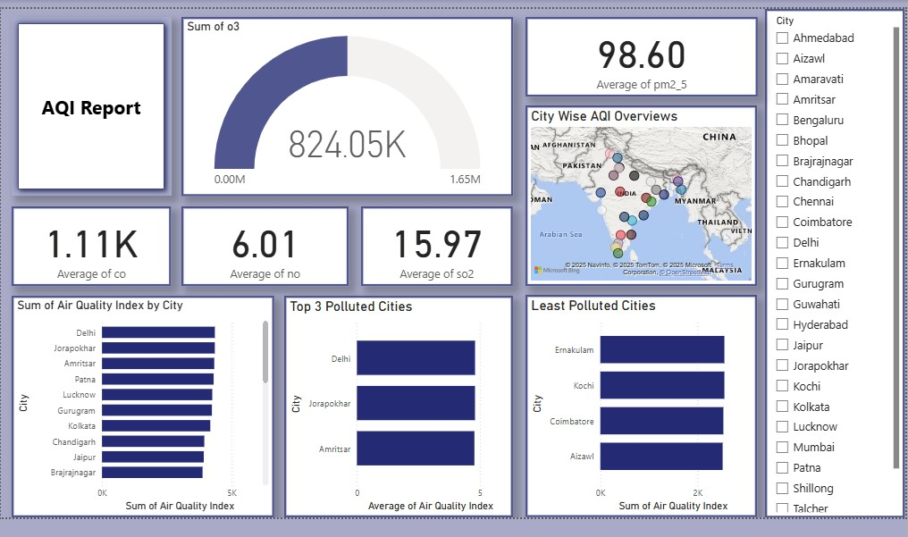
Visualizing the Dashboard
Air Pollution Data of India (2020 – 23)

Slide 8
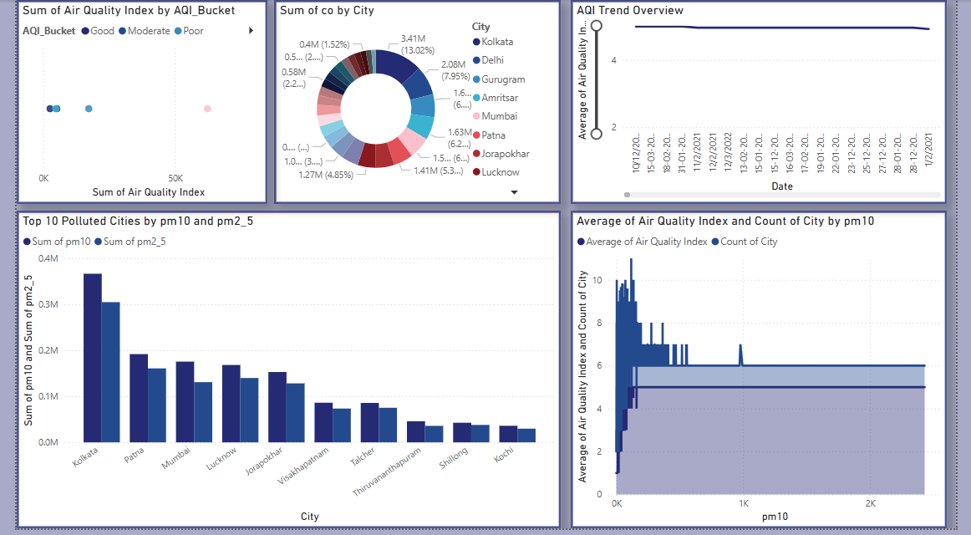
Data (2020 – 23)

Slide 9
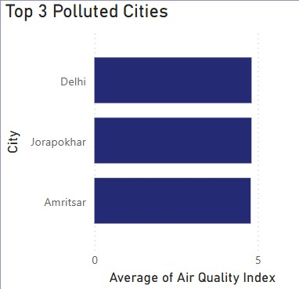
Turning Data into Actionable Insights
Key Pollution : Where and Why
Identifying Delhi, Jorapokhar, and Amritsar as temporal pollution hotspots, revealing patterns of elevated AQI levels during specific periods (e.g., winter months, certain times of the day).
Understanding these temporal and geographical hotspots allows for more targeted strategies to mitigate air pollution, such as focusing on traffic management during peak hours in Delhi and addressing potential local sources in Jorapokhar and Amritsar.

Slide 10
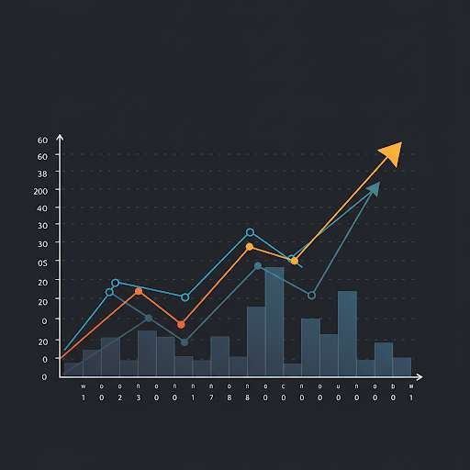
Looking Ahead
Challenges :
Data accuracy & reliability (diverse sources).
Ensuring real-time data flow.
Scalability for growing data volumes.
User adoption & board accessibility
Future Enhancements :
Integrate weather data for forecasting.
Personalized health-based recommendations.
Predictive modeling of AQI levels.
Develop a mobile application.
Incorporate citizen science data.
Challenges and Future Enhancement

Slide 11

Breathing Easier with Data
Conclusion
Reiterate the importance of air quality monitoring and the potential of a well-designed dashboard to empower individuals and communities.

Slide 12
Thank You
Shruti Kumari Hela

